Slide 1
Chapter 6
Single Stage IC Amplifiers

Slide 2
Outline
Introduction
Biasing mechanism for ICs
High frequency response
The CS and CE amplifier with active loads
High frequency response of the CS and CE amplifier
The CG and CB amplifier with active loads
The Cascode amplifier
The CS and CE amplifier with source(emitter)degeneration

Slide 3
Introduction
Design philosophy of integrated circuits
Comparison of the MOSFET and the BJT (Self-Study)

Slide 4
Design Philosophy of Integrated Circuits
Strive to realize as many of the functions required as possible using MOS transistors only.
    Large even moderate value resistors are to be avoided
    Constant-current sources are readily available.
    Coupling and bypass capacitors are not available to be used, except for external use.

Slide 5
Design Philosophy of Integrated Circuits
Low-voltage operation can help to reduce power dissipation but poses a host of challenges to the circuit design.
Bipolar integrated circuits still offer many exciting opportunities to the analog design engineer.

Slide 6
Biasing mechanism for ICs
  MOSFET Circuits
    The basic MOSFET current source
    MOS current-steering circuits
  BJT Circuits
    The basic BJT current source
    BJT Current-steering circuits

Slide 7
Biasing mechanism for ICs(cont’d)
  Current-mirror circuits with improved performance
    Cascode MOS mirrors
    A bipolar mirror with base-current compensation
    The wilson current mirror
    The wilson MOS mirror
    The widlar current source

Slide 8
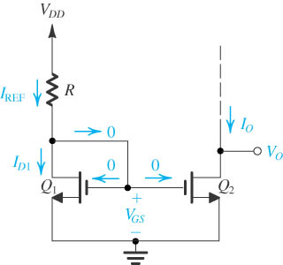
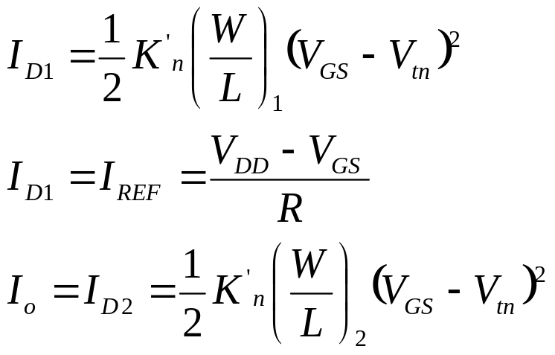
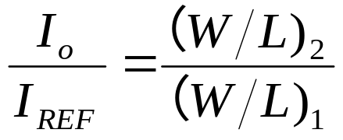
The Basic MOSFET Current Source

Slide 9
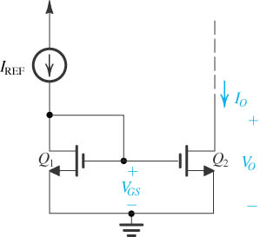
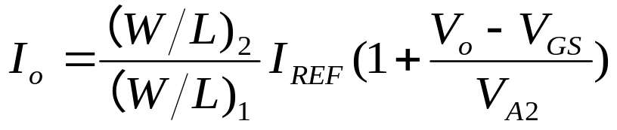
The Basic MOSFET Current Mirror

Slide 10
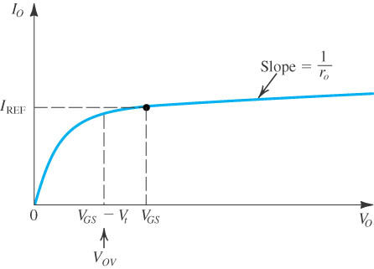

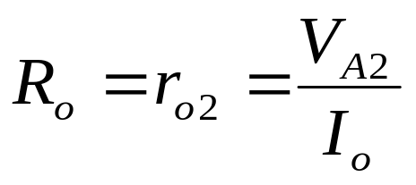
Output Characteristic

Slide 11
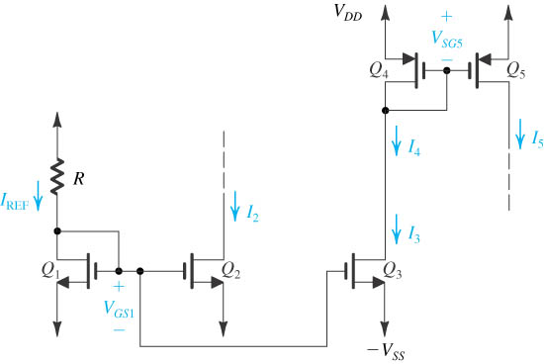
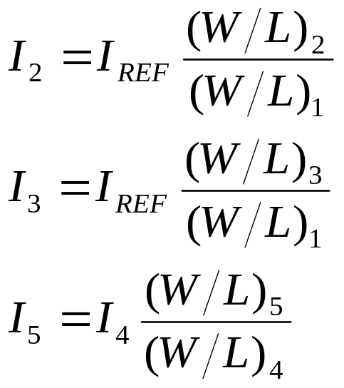
MOS Current-Steering Circuits

Slide 12
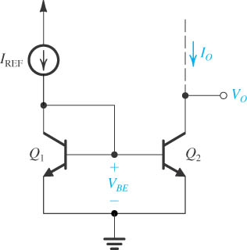
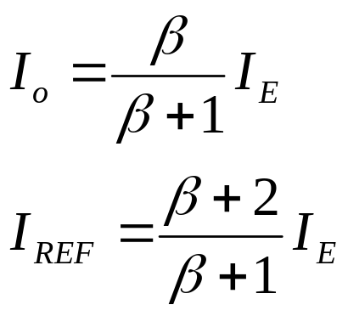
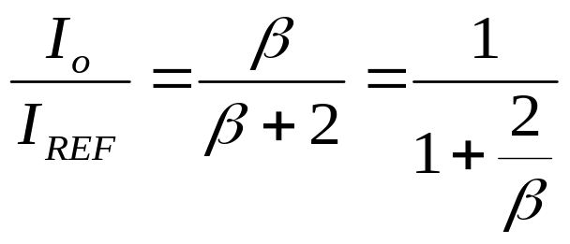
The Basic BJT Current Mirror

Slide 13
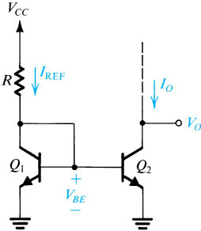
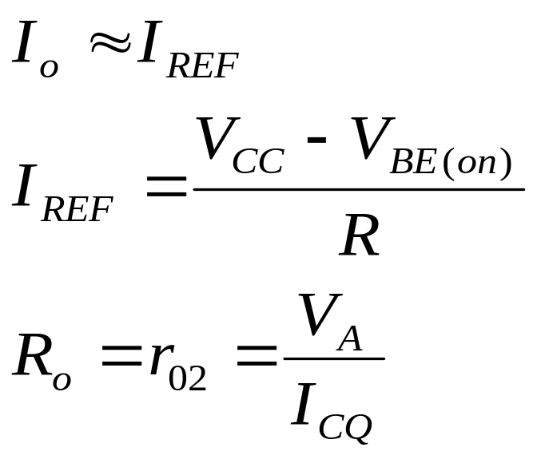
A Simple BJT Current Source.

Slide 14
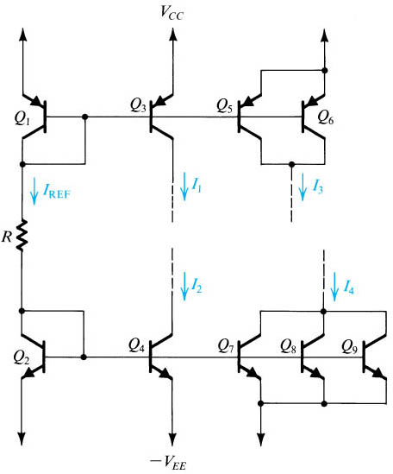
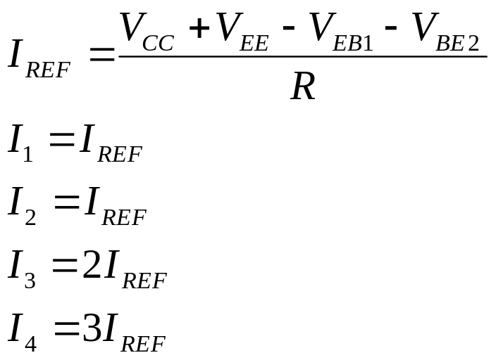
Current Steering

Slide 15
Current-Mirror Circuits with Improved Performance
Two performance parameters need to be
improved:
The accuracy of the current transfer ratio of the mirror.
The output resistance of the current source.

Slide 16
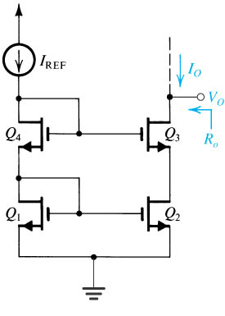
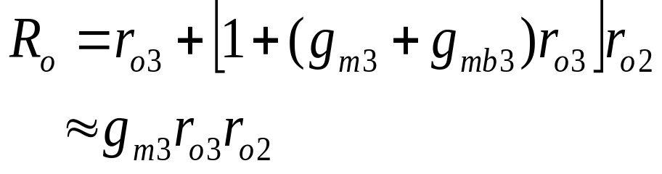
Cascode MOS Current Mirror

Slide 17
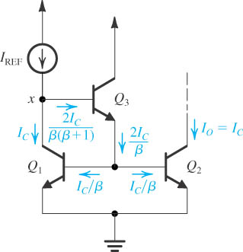
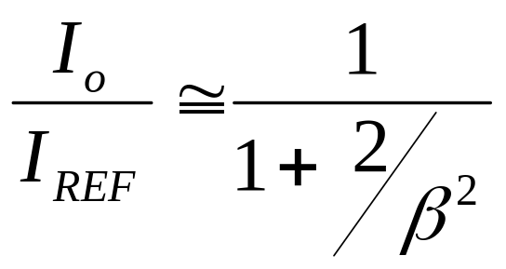
Current Mirror with Base-Current Compensation

Slide 18
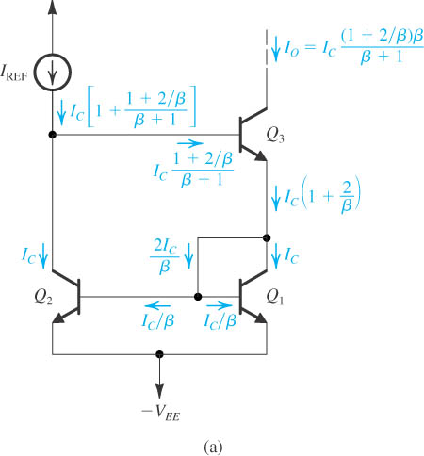
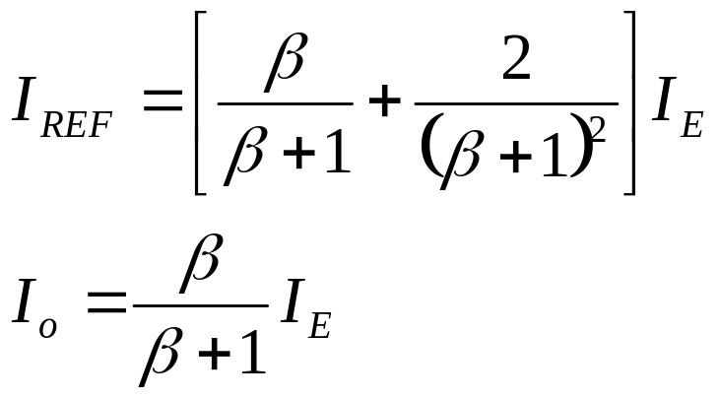

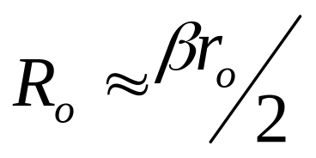
The Wilson Bipolar Current Mirror

Slide 19
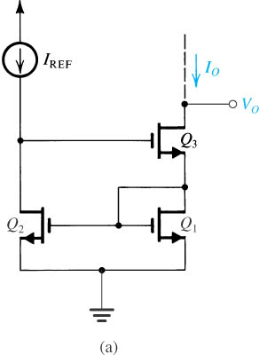
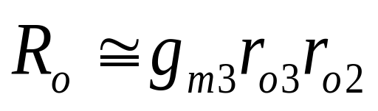
The Wilson MOS Current Mirror

Slide 20
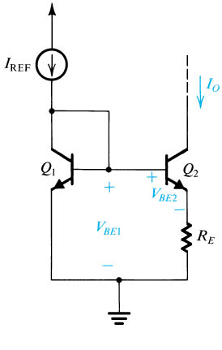
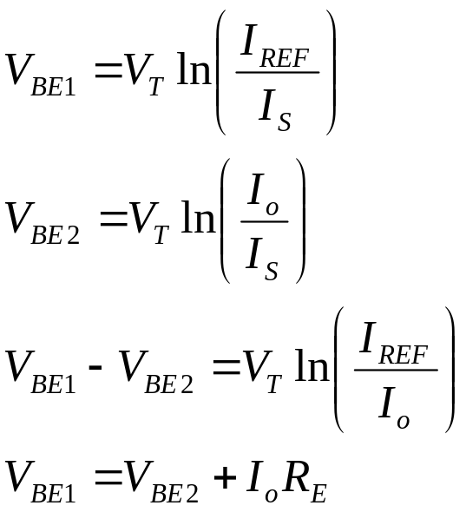
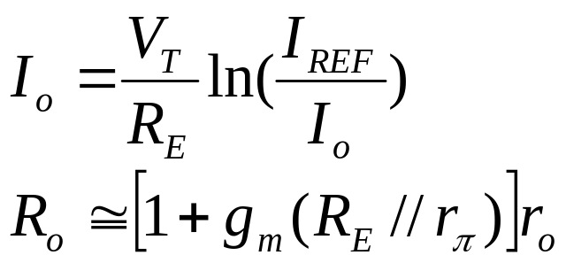
The Widlar Current Source

Slide 21
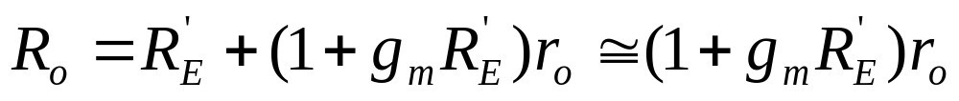
The advantages of Widlar Current Source
Example6.2 p518
Widlar circuit allows the generation of a small constant current using relatively small resistors( saving in chip area ).
Another important characteristic of the widlar current source is that its output resistance is high.

Slide 22
High Frequency Response
The high-frequency gain function
Determining the 3-dB frequency
  By definition
  Dominant-pole
  Open-circuit time constants

Slide 23
Introduction of Frequency Response
Why shall we study the frequency response?
Actual transistors exhibit charge storage phenomena that limit the speed and frequency of their operation.

Slide 24
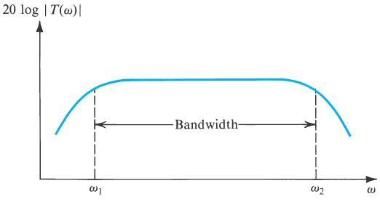
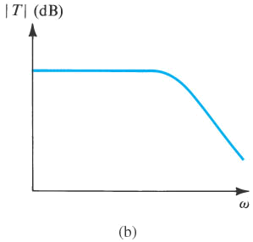
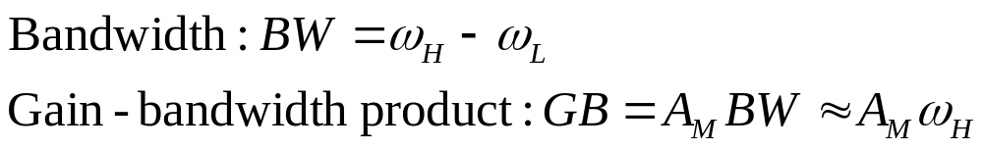
Amplifier Transfer Function
(a) a capacitively coupled amplifier (b) a direct-coupled amplifier

Slide 25




The Gain Function
Gain function
Midband: No capacitors in effect
Low-frequency band: coupling and bypass capacitors in effect
High-frequency band: transistor internal capacitors in effect

Slide 26
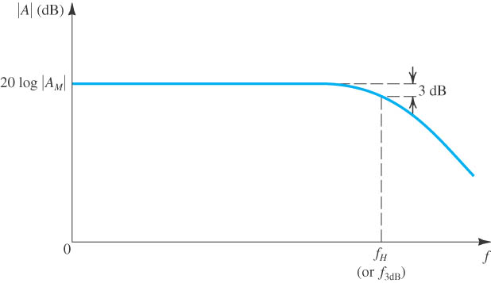
The High-Frequency Gain Function
Directly coupled
Low pass filter
gain does not fall off at low frequencies
Midband gain A_{M} extends down to zero frequency

Slide 27
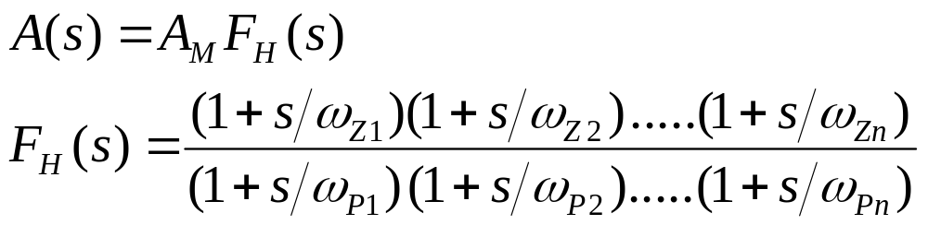
The High-Frequency Gain Function
Gain function
ω_{P1} , ω_{P2} , ….ω_{Pn} are positive numbers representing the frequencies of the n real poles.
ω_{Z1} , ω_{Z2} , ….ω_{Zn} are positive, negative, or infinite numbers representing the frequencies of the n real transmission zeros.

Slide 28
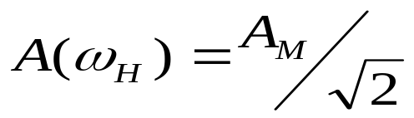

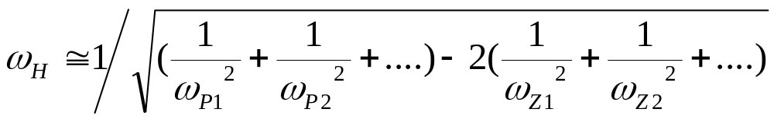
Determining the 3-dB Frequency
Definition
or
Assume ω_{P1}< ω_{P2} < ….<ω_{Pn} and ω_{Z1} < ω_{Z2} < ….<ω_{Zn}

Slide 29
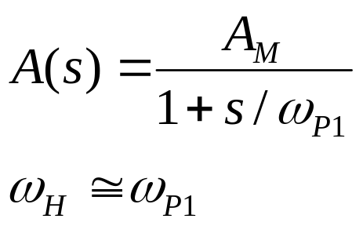
Determining the 3-dB Frequency
Dominant pole
If the lowest-frequency pole is at least two octaves (a factor of 4) away from the nearest pole or zero, it is called dominant pole. Thus the 3-dB frequency is determined by the dominant pole.
Single pole system

Slide 30
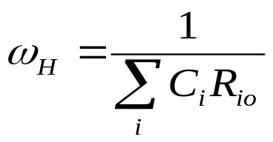
Determining the 3-dB Frequency
Open-circuit time constants
To obtain the contribution of capacitance C_{i}
  Reduce all other capacitances to zero
  Reduce the input signal source to zero
  Determine the resistance R_{io} seen by C_{i}
This process is repeated for all other capacitance in the circuit.

Slide 31
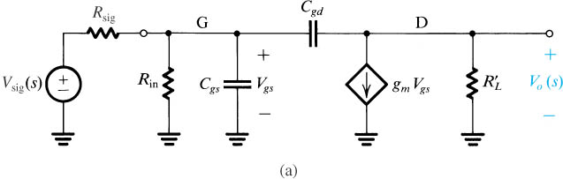
Example for Time Constant Analysis
High-frequency equivalent circuit of a MOSFET amplifier.
The configuration is common-source.

Slide 32
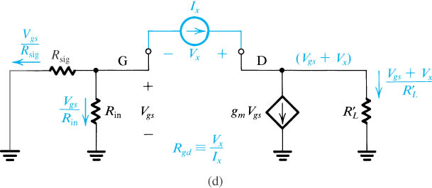
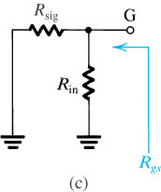
Example for Time Constant Analysis
Circuit for determining the resistance seen by C_{gs} and C_{gd}

Slide 33
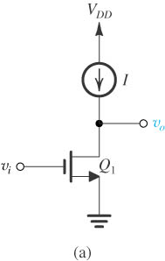
The CS Amplifier with Active Load
Current source acts as an active load.
Source lead is signal grounded.
Active load replaces the passive load.

Slide 34
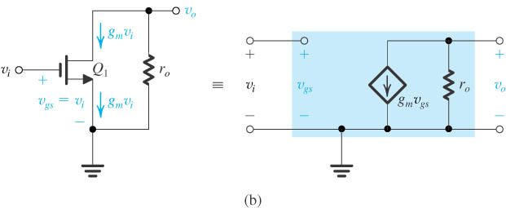

The CS Amplifier with Active Load
Small-signal analysis of the amplifier performed both directly on the circuit diagram and using the small-signal model explicitly.
The intrinsic gain

Slide 35
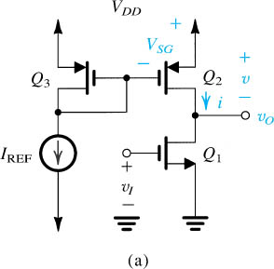
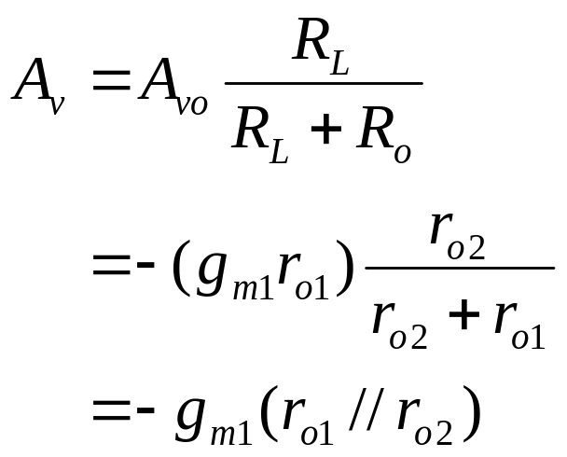
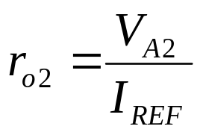
The CS Amplifier with Active Load

Slide 36
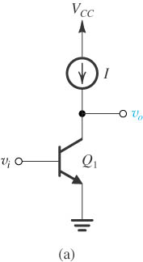
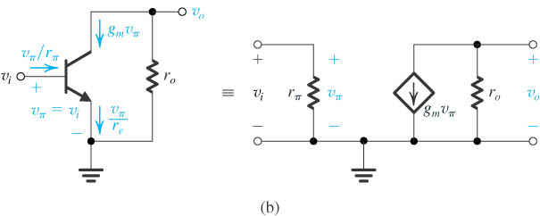
The CE Amplifier with Active Load
Active-loaded common-emitter amplifier.
Small-signal analysis of the amplifier performed both directly on the circuit and using the hybrid-π model explicitly.

Slide 37
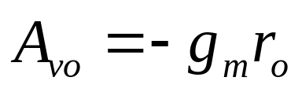
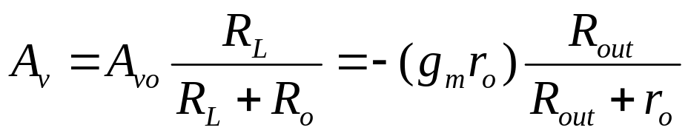
The CE Amplifier with Active Load
Performance of the amplifier
Intrinsic gain
Voltage gain

Slide 38
High-Frequency Response of the CS and CE Amplifier
Miller’s theorem.
Analysis of the high frequency response.
  Using Miller’s theorem.
  Using open-circuit time constants.

Slide 39



Miller’s Theorem
Impedance Z can be replaced by two impedances:
Z₁ connected between node 1 and ground
Z₂ connected between node 2 and ground

Slide 40
Miller’s Theorem
The miller equivalent circuit is valid as long as the conditions that existed in the network when K was determined are not changed.
Miller theorem can be used to determining the input impedance and the gain of an amplifier; it cannot be applied to determine the output impedance.

Slide 41

High-Frequency Equivalent-Circuit Model of the CS Amplifier

Slide 42


Analysis Using Miller’s Theorem
Neglecting the current through C_{gd}
Approximate equivalent circuit obtained by applying Miller’s theorem.
This model works reasonably well when R_{sig} is large.
The high-frequency response is dominated by the pole formed by R_{sig} and C_{in}.

Slide 43


Analysis Using Miller’s Theorem
Using miller’s theorem the bridge capacitance C_{gd} can be replaced by two capacitances which connected between node G and ground, node D and ground.
The amplifier with one zero and two poles now is changed to only one pole system.
The upper 3dB frequency is only determined by this pole.

Slide 44




Analysis Using Open-Circuit Time Constants

Slide 45



Analysis Using Open-Circuit Time Constants

Slide 46



The Situation When R_{sig} Is Low
High-frequency equivalent circuit of a CS amplifier fed with a signal source having a very low (effectively zero) resistance.

Slide 47



The Situation When R_{sig} Is Low
Bode plot for the gain of the circuit in (a).

Slide 48
The Situation When R_{sig} Is Low
The high frequency gain will no longer be limited by the interaction of the source resistance and the input capacitance.
The high frequency limitation happens at the amplifier output.
To improve the 3-dB frequency, we shall reduce the equivalent resistance seen through G(B) and D(C) terminals.

Slide 49


High-Frequency Equivalent Circuit of the CE Amplifier
Thevenin theorem:

Slide 50






Two Methods to Determine the 3-dB Frequency
(b) Equivalent Circuit with Thévenin Theorem Employed
Using Miller’s theorem
Using open-circuit time constants

Slide 51


Active-Loaded CG Amplifier
The body effect in the common-gate circuit can be fully accounted for by simply replacing g_{m} of the MOSFET by (g_{m}+g_{mb})

Slide 52

Active-Loaded CG Amplifier
Small-signal analysis performed directly on the circuit diagram with the T model of (b) used implicitly.
The circuit is not unilateral.

Slide 53

Active-Loaded CG Amplifier
Circuit to determine the output resistance.

Slide 54



Performance of the Active Loaded CG Amplifier
Input resistance
Open-circuit voltage gain
Output resistance

Slide 55

Frequency Response of the Active Loaded CG Amplifier
A load capacitance C_{L} is also included.

Slide 56
Frequency Response of the Active Loaded CG Amplifier
Two poles generated by two capacitances.
Both of the two poles are usually much higher than the frequency of the dominate input pole in the CS amplifier.

Slide 57


Active-Loaded Common-Base Amplifier
Small-signal analysis performed directly on the circuit diagram with the BJT T model used implicitly

Slide 58



Performance of the Active Loaded CB Amplifier
Input resistance
Open-circuit voltage gain
Output resistance

Slide 59
Comparisons between CG(CB) and CS(CE)
Open-circuit voltage gain for CG(CB) almost equals to the one for CS(CE)
Much smaller input resistance and much larger output resistance
CG(CB) amplifier is not desirable in voltage amplifier but suitable as current buffer.
Superior high frequency response because of the absence of Miller’s effects
Cascode amplifier is the significant application for CG(CB) circuit

Slide 60
The Cascode Amplifier
About cascode amplifier
  Cascode configuration
  A CG(CB)amplifier stage in cascade with a CS(CE) amplifier stage
  Treated as single-stage amplifier
  Significant characteristic is to obtain wider bandwidth but the equal dc gain as compared to CS(CE) amplifier
The MOS cascode
The BJT cascode

Slide 61

The MOS Cascode
Q₁ is CS configuration and Q₂ is CG configuration.
Current source biasing.

Slide 62

Small Signal Equivalent Circuit
The circuit prepared for small-signal analysis with various input and output resistances indicated.

Slide 63

Small Signal Equivalent Circuit
The cascode with the output open-circuited

Slide 64



Performance of the MOS Cascode
Input resistance
Open-circuit voltage gain
The cascoding increases the magnitude of the open-circuit voltage gain from A_{o} to A_{o}²
Output resistance

Slide 65

Frequency Response of the MOS Cascode
The cascode circuit with the various transistor capacitances

Slide 66

Frequency Response of the MOS Cascode
Effect of cascoding on gain and bandwidth in the case R_{sig} =0.
Cascoding can increase the dc gain by the factor A₀ while keeping the unity-gain frequency constant.
Note that to achieve the high gain, the load resistance must be increased by the factor A₀.

Slide 67

The BJT Cascode
The BJT cascode amplifier.
It is very similar to the MOS cascode amplifier.

Slide 68

The BJT Cascode
The circuit prepared for small-signal analysis with various input and output resistances indicated.
Note that r_{x} is neglected.

Slide 69

The BJT Cascode
The cascode with the output open-circuited.

Slide 70

Frequency Response of the BJT Cascode
Note that in addition to the BJT capacitances C_{π} and C_{μ}, the capacitance between the collector and the substrate C_{cs} for each transistor are also included.

Slide 71

The CS and CE Amplifier with Source (Emitter) Degeneration
A CS amplifier with a source-degeneration resistance R_{s}

Slide 72


The CS and CE Amplifier with Source (Emitter) Degeneration
Circuit for small-signal analysis.
Circuit with the output open to determine A_{vo}.

Slide 73




Performances of the CS Amplifier with Source Degeneration
Input resistance
Output resistance
Intrinsic voltage gain
The resistance R_{s} has no effect on A_{vo}
Short-circuit transconductance

Slide 74


Performances of the CS Amplifier with Source Degeneration
R_{s} reduces the amplifier tranconductance and increases its output resistance by the same factor.
This factor is the amount of negative feedback
Improve the linearity of amplifier.

Slide 75

High Frequency Equivalent Circuit

Slide 76

Frequency Response
Determining the resistance R_{gd} seen by the capacitance C_{gd}.

Slide 77

The CE Amplifier With an Emitter Resistance
Emitter degeneration is more useful than source degeneration. The reason is that emitter degeneration increases the input resistance of the CE amplifier.

Slide 78


The CE Amplifier With an Emitter Resistance
The presence of r_{o} reduces the effect of R_{e} on increasing R_{in}.
This is because r_{o} shunts away some of the current that would have flowed through R_{e.}

Slide 79


The CE Amplifier With an Emitter Resistance
The output resistance R_{o} is identical to the value of R_{out} for CB circuit.

Slide 80
Summary of the CE Amplifier With an Emitter Resistance
Including a relatively small resistance R_{e} in the emitter of the active-loaded CE amplifier:
  Reduces its effective transconductance by the factor (1+g_{m} R_{e}).
  Increases its output resistance by the same factor.
  Reduces the severity of the Miller effect and correspondingly increases the amplifier bandwidth.
The input resistance R_{in} is increased by a factor that depends on R_{L}.
Emitter degeneration increases the linearity of the amplifier.

Slide 81
The Source (Emitter) Follower
Self-study
Read the textbook from pp635-641

Slide 82
Some Useful Transistor Pairing
The transistor pairing is done in a way that maximize the advantages and minimizes the shortcomings of each of the two individual configurations.
The pairings:
  The CD-CS, CC-CE and CD-CE configurations.
  The Darlington configuration.
  The CC-CB and CD-CG configurations.

Slide 83

The CD-CS, CC-CE and CD-CE Configurations
Circuit of CD–CS amplifier.
The voltage gain of the circuit will be a little lower than that of the CS amplifier.
The advantage of this circuit lies in its bandwidth, which is much wider than that obtained in a CS amplifier.
The reason that widen the bandwidth is the lower equivalent resistance between the gate of Q₂ and ground.

Slide 84

The CD-CS, CC-CE and CD-CE Configurations
CC–CE amplifier.
This circuit has the same advantage compared with the MOS counterpart.
The additional advantage is that the input resistance is increased by the factor equal to (1+β₁) .

Slide 85

The CD-CS, CC-CE and CD-CE Configurations
BiCMOS version of this CD–CE amplifier.
Q1 provides the amplifier with infinite input resistance.
Q2 provides the amplifier with a high g_{m} as compared to that obtained in the MOSFET circuit and hence high gain.

Slide 86

The Darlington Configuration
The Darlington configuration.
The total β = β₁β₂

Slide 87

The CC-CB and CD-CG Configurations
A CC–CB amplifier.

Slide 88

The CC-CB and CD-CG Configurations
Another version of the CC–CB circuit with Q₂ implemented using a pnp transistor.

Slide 89

The CC-CB and CD-CG Configurations
A CD-CG amplifier.

Slide 90
The CC-CB and CD-CG Configurations
A CC–CB amplifier
Low frequency gain approximately equal to that of the CB configuration.
The problem of low input resistance of CB is solved by the CC stage.
Neither the CC nor the CB amplifier suffers from the Miller’s effect, the CC-CB configuration has excellent high-frequency performance.

